Slide 1
Terrorism and Continuity
Presented by Anthony Buller
Regional Continuity Manager
FEMA Region III
May 2016

Slide 2
Overview
Scope and Purpose
Concepts to Consider
Targets
Boston Marathon Bombing
Continuity Planning
Reconstitution
Summary

Slide 3
Scope and Purpose
The purpose of this briefing is to identify the possible implications of a terrorism event on Continuity of Operations
There are a multitude of sources for information on emergency response to a terrorism event available through various Federal, State, and local agencies.
The scope of this briefing is to address some of the continuity impacts and considerations such as:
Essential functions sustainment
Facility issues
Human resource challenges
Devolution
Reconstitution

Slide 4
Concepts to Consider
On September 16th, 2013 an active shooter incident occurred at the Navy Yard in Washington DC
“There was a feeling of powerlessness. I’m in command of 60,000 people, and I can do nothing. I am locked down with my phone.” – Vice Admiral William Hilarides, Naval Sea Systems Command

Slide 5
Concepts to Consider
Malicious intent, not random natural occurrence
Fear of being targeted as an organization
Running or moving does not necessarily reduce the threat
Coordinated/Secondary attacks
Unknown timeline, no clear end
Ambiguous decision points on activation, relocation, or reconstitution

Slide 7
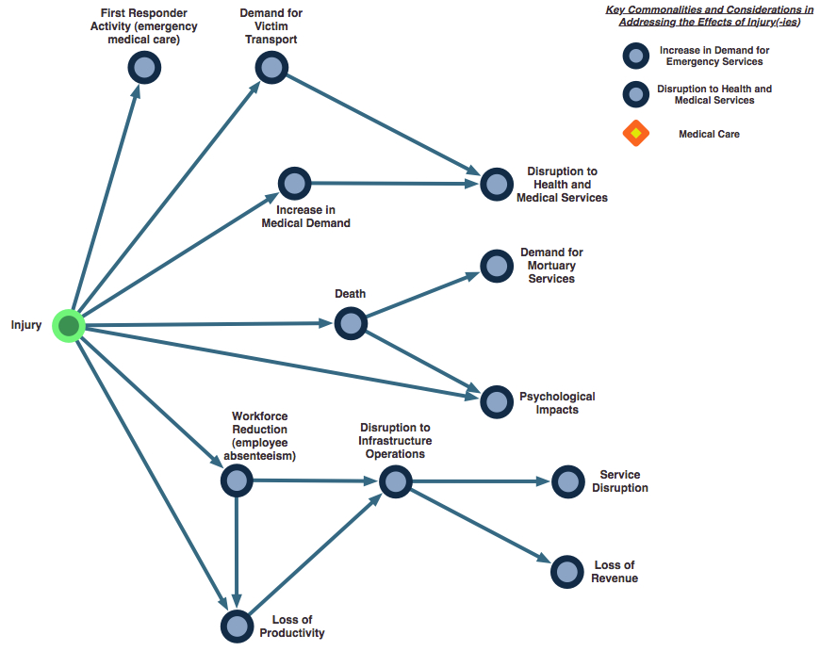
What’s Missing
= Continuity Areas of Interest

Slide 8
Targets
Anything can be a target
Focus on likely targets and implications to mitigate the possible disruptions
There are three broad categories of targets:
Government assets
Critical infrastructure
Densely populated areas

Slide 9
Target: Government Assets
Examples
Impact of Attack
Government buildings
Courts, jails, offices, parks
Police and fire stations
Transportation fleets
Warehouses, telecommunications
Direct victimization of government and response personnel and assets
Symbolic value and associated psychological impact
Continuity elements most impacted:
Essential Functions
Succession/Authorities
Human Resources
Alternate Facilities
Essential Records
Reconstitution

Slide 10
Target: Critical Infrastructure
Examples
Impact of Attack
Power stations
Telecommunication lines
Roads, bridges, train tracks
Gas, water, sewer lines
Food and agricultural sources
Disruption to government and businesses due to dependencies
Cascading consequences multiply the effect of single attack
Continuity elements most impacted:
Human Resources
Continuity Communications
Alternate Facilities
Reconstitution

Slide 11
Target: Densely Populated Areas
Examples
Impact of Attack
Hotels, Restaurants, Malls
Schools, Places of Worship
Sporting and Entertainment Events
General “downtown” areas
Potential for mass casualties
Opportunistic attacks may seem random and produce widespread fear
Long term economic impact
Continuity elements most impacted:
Human Resources
Succession/Authorities
Continuity Communications
Test, Training, and Exercises

Slide 12
Boston Marathon Bombing
Developing and Maintaining Pre-Existing Professional Relationships
Enhances capacity and capabilities to respond to complex incidents in a manner that cannot tangibly be captured or addressed in a written plan
Pre-existing professional relationships among key leadership and front-line personnel
Planning for special events
Training and exercising
Experience with prior large-scale events
Participation in Multi-Jurisdictional Exercises
Enhances capabilities and proficiency to respond
Practices response and coordination role and responsibilities
Initial response to bombings was similar to 2012 tabletop exercise

Slide 13
Boston Marathon Bombing
Formal Mutual Aid Agreements
Incident required extensive coordination of mutual aid assets
Requesting and deploying Explosive Ordinance Disposal (EOD) teams
Increasing police presence
Existing relationships and agreements
EOD assets from New Hampshire, Connecticut, and Rhode Island State Police Departments
New England State Compact activated for states to request and receive interstate law enforcement assets

Slide 14
Boston Marathon Bombing
Decision to Shelter-In-Place
Overarching objective was to maintain public safety and to capture the suspect
Leadership cognizant of the importance of the decision and communicating it prior to peak commuting times
Suspending all transit services and local leaders collectively scripting the message to the public
Impact and burden on residents and business owners
Regular re-assessments on the shelter-in-place request throughout the day based on current or new information
Unforeseen impacts to critical infrastructure and supply chain
Effective Use of Emergency Alerting
Traditional media sources and emergency alerting systems used by Watertown, Boston, and Massachusetts Emergency Management Agency
Public received alerts through various tools with update information about the shelter-in-place request throughout the day

Slide 15
Boston Marathon Bombing
Frequent and Coordinated Public Messaging
Organizational leadership understood the importance of frequent and coordinated communication with the media and general public
Goal of providing information from key city and state leadership as often as possible
Key leaders worked together to craft clear, concise, unified messages they could deliver regarding the incident, its impacts, and measures taken in the aftermath
Major lesson:
The networks and partnerships that are built with law enforcement and others who provide critical decision information may not be available at the time you need the information. Work to ensure access even during the crisis phase.

Slide 16
Boston Marathon Bombing
http://www.mass.gov/eopss/docs/mema/after-action-report-for-the-response-to-the-2013-boston-marathon-bombings.pdf

Slide 17
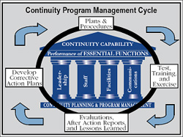
Continuity Planning

Slide 18
Leadership
Does your planning account for?
Monitoring of, accessing, and adapting to intelligence reports and threat information?
Security measures for senior personnel who may be traveling?
Decision-making and plan activations:
During an environment of uncertainty and/or fear?
In the absence of senior leadership?
Prioritization/Re-prioritization of essential functions and additional duties created by the terrorism event?
Interaction with and response to the directions of first responders, law enforcement, and investigative personnel?

Slide 19
Staff
Does your planning account for?
Staff mental health, morale, and possible reluctance during times of fear and uncertainty?
Communications with staff during and after the incident?
Employee family support?
Security measures for staff who may be on travel during a terrorism incident?
Altering, adding, or blocking staff access permissions during an incident?
Operational security considerations of your plan’s confidentiality and dissemination?
Who has the authority to convey information to staff and partners?
Insider threat awareness and suspicious behavior reporting?
The effect of the incident in recovery and reconstitution efforts?

Slide 20
Facilities
Does your planning account for?
Conducting operations from facilities during heightened security?
Ensuring that leadership can make an informed decision on whether the alternate site is any “safer” from the terrorism threat?
Operating when your facility is a specific target?
Consideration of secondary attacks?
Providing post-incident security and access control at primary and alternate facilities?
Operational security considerations pertaining to the visibility and public knowledge of your alternate facility location?
Effects of critical infrastructure and supply chain disruptions on prolonged operations?
Integrating and coordinating reconstitution operations with safety, law enforcement, and investigative authorities?
Ensuring physical security and protective measures for primary and alternate facilities?

Slide 21
Communications and Technology
Does your planning account for?
Ensuring and confirmation message and records authenticity and integrity?
Security protocols on what types of information should NOT be communicated?
Altering or removing user accounts (email, network, communications) should an insider threat be identified?
Adequately maintaining situational awareness for all staff in all phases of continuity?
Redundancy in communications?
Interoperable communications?

Slide 22
Reconstitution
Real World Reconstitution
It took 17 months after the Navy Yard shooting for personnel to reoccupy Building 197
The Navy completed a $6.4 million renovation of the building
During the renovation, personnel were relocated to a former Coast Guard facility at Buzzard Point

Slide 23
Reconstitution
Real World Reconstitution
Many personnel refuse to go back to Building 197 and the Navy has accommodated their wishes by transferring them to other jobs in different buildings
Personnel returned on a staggered weekly move-in schedule over the course of nine weeks

Slide 24
Reconstitution
Real World Reconstitution
“The Navy has done a wonderful job of re-creating that space so that it won’t be haunted by the memories and by the unresolved emotions of people who were there that day. They have done a herculean effort at reclaiming and rededicating that space. There may be people so traumatized they don’t feel comfortable about being back in there. Some will have to figure out ways to expunge their fear. But the institution has done as much as they can to make the building a safe place.” – Commander Paul Anderson, Navy Chaplain

Slide 25
Summary
Scope and Purpose
Concepts to Consider
Targets
Boston Marathon Bombing
Continuity Planning
Reconstitution
Summary

Slide 26
Questions?
Anthony Buller
Regional Continuity Manager
Federal Emergency Management Agency
Region III, Philadelphia, PA
anthony.buller@fema.dhs.gov

